Slide 1
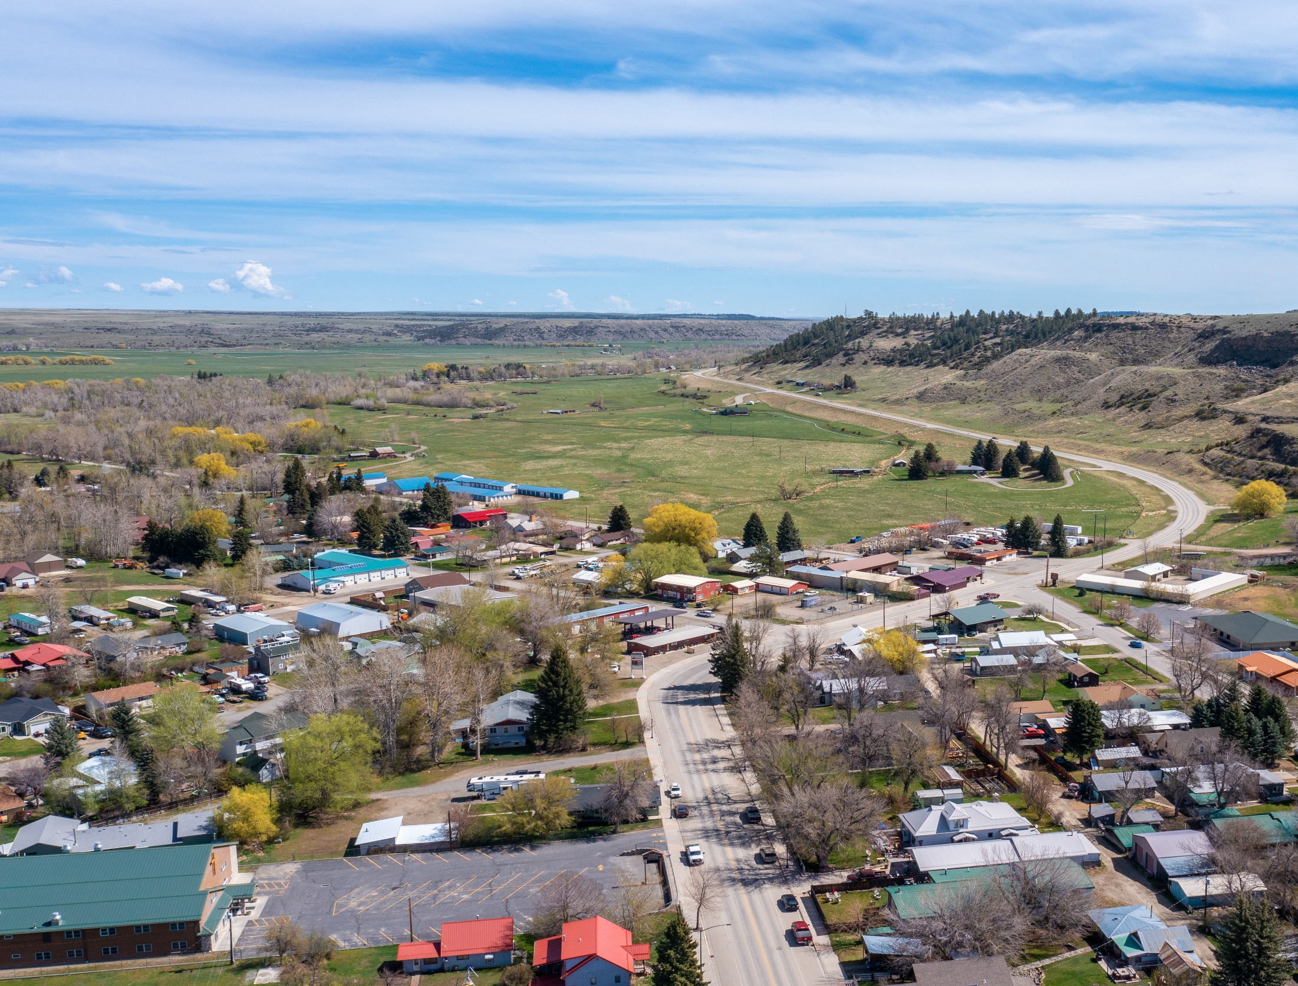

Absarokee Sewer and Water District
Wastewater System Preliminary Engineering Report

Slide 2
Preliminary Engineering Report Process
Preliminary Engineering Report Defined
Known as “PER”
Required by State & Federal Funding Agencies
Engineer Evaluates Entire System
Identifies Deficiencies
Develops Solution Alternatives & Costs
PER Supports Grant Funding Applications

Slide 3
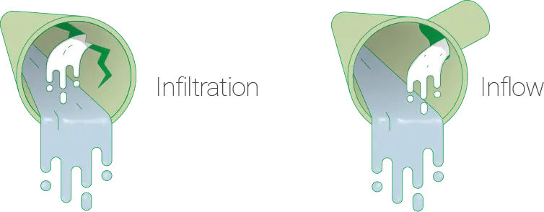
Project Background
Existing Wastewater System
Collection system originally installed in 1937 with extensions and upgrades throughout the years
Recent wastewater treatment system upgrades completed, Aging Headworks and Lift Station
Excessive Infiltration and Inflow (I&I)

Slide 4
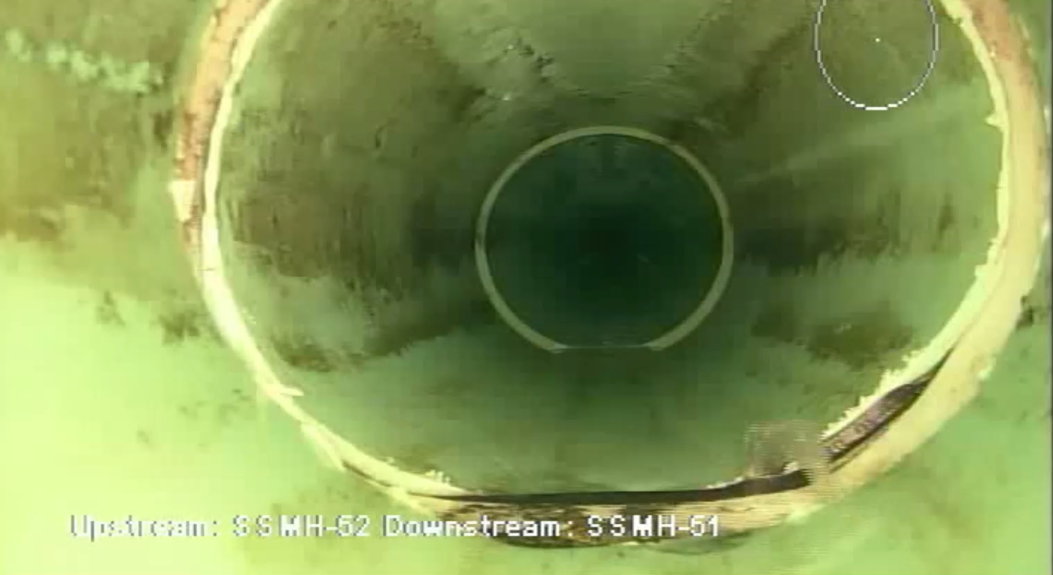
Infiltration and Inflow
I&I
Treatment facility at capacity, moratorium on new Sewer connections
Video inspection of sewer completed
Source of inflow identified by District, requiring further investigation

Slide 5
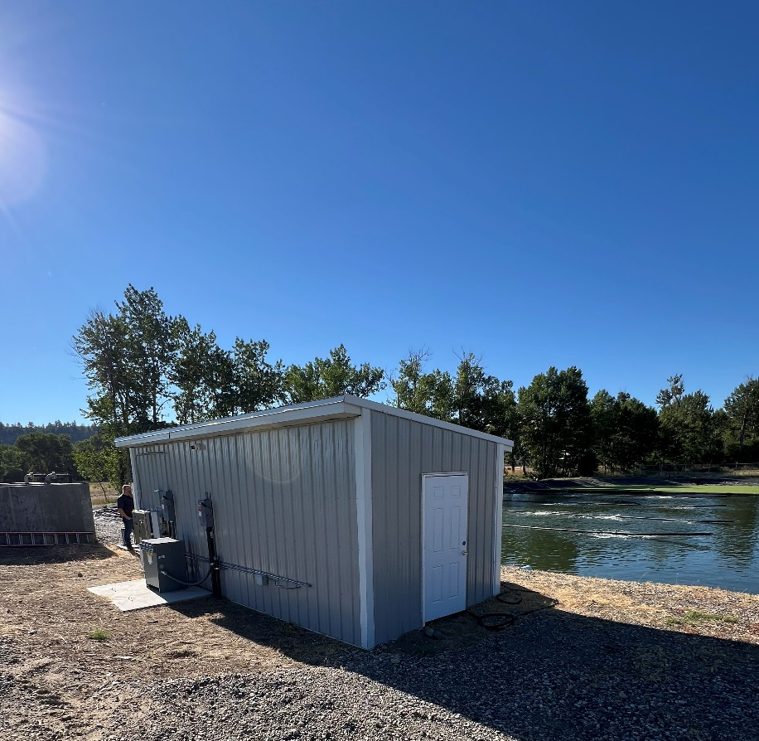
Headworks
Safety and Operation
Lack of proper heating, insulation, ventilation
Lack of reliable water supply
Underground pump non-functional
Desire for SCADA to aid in operation

Slide 6
Solution
Collection System
Combination of Dig and Replace and Trenchless methods to Rehabilitate Sewer Mains
Project Phasing recommended as funding allows, based on severity of I&I
Inflow investigation
Collection System
Upgrades to Headworks Building, including upgrades to pumps and upgrades needed for safety and proper operation

Slide 7
Project Schedule
PER Finalized January 2025
Grant Applications Submitted Spring 2026
Funding Available Spring 2028
Design Spring 2028
Bidding Summer 2028
Construction Summer/Fall 2028

Slide 8
Funding the Project
Conclusions and Recommendations from the PER include:
Discussion of funding alternatives for the project
Loan funds that might require the assistance of bond counsel to help with a rate increase process
Grant opportunities: MCEP, RRGL, CDBG, USDA Rural Development, Others
Grant considerations:
Environmental Review
Public Health and Safety
Renewable Resource Benefit
Financial Need
Technical Design and Long-term Solution
Long-term Planning and Management
Available Funding from Other Sources (match) and Financial Feasibility
Public Benefit including Business or Tax Base Expansion
Community Support

Slide 9
Public Participation
How the Public Can Help with the PER and Funding Process
Provide input on any issues they experience with the system
Identify how the project will benefit the public health and safety or economic well-being of local citizens
Attend Public Meetings and/or comment on surveys
Write letters of support

Slide 10
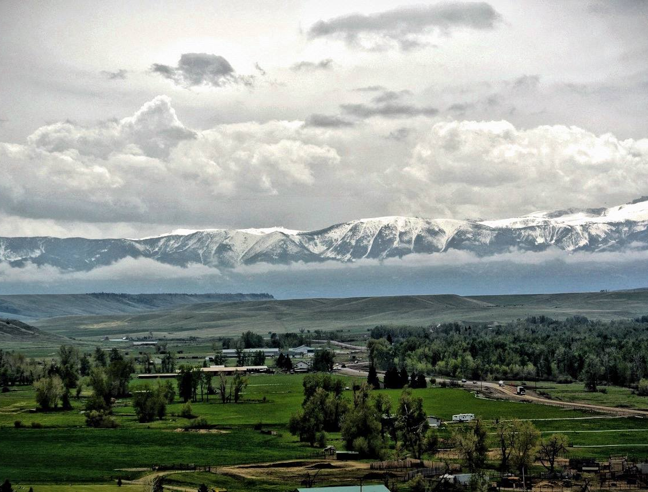
Absarokee Sewer and Water District
Questions & Comments?
Wastewater System Preliminary Engineering Report

